Slide 2
Who is this qualification for?
The Pearson BTEC National Extended Certificate in Sport is an Applied General qualification for post-16 learners who want to continue their education through applied learning and who aim to progress to higher education and ultimately to employment in the sport sector.

Slide 3
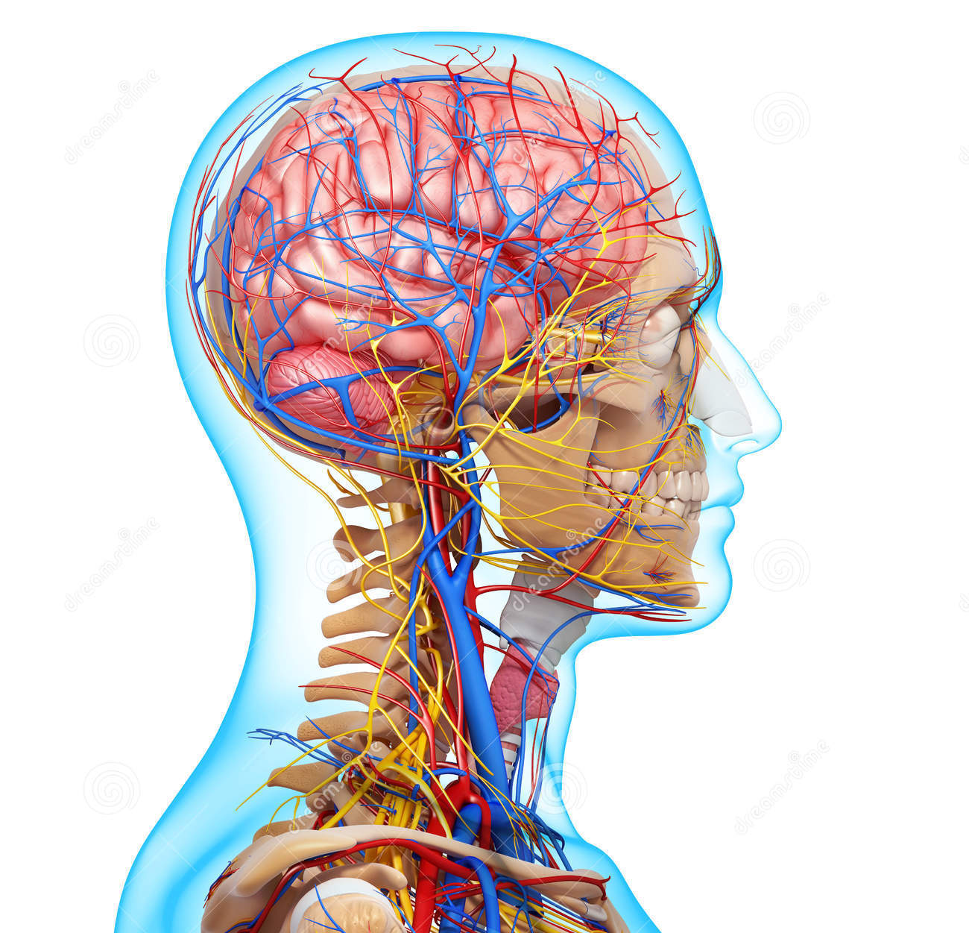
Unit 1: Anatomy and Physiology
Content
Learners explore how the skeletal, muscular, cardiovascular and respiratory systems function and the fundamentals of the energy systems.
Assessment
This unit is an externally marked exam. It is set and marked by Pearson.

Slide 4
Unit 2: Fitness Training and Programming for Health, Sport and Well-being
Unit Content
Learners explore client screening and lifestyle assessment, fitness training methods and fitness programming to support improvements in a client’s health and well-being
Assessment
This unit will be assessed under supervised conditions.
Learners will be given a case study one week before the supervised assessment period to carry out preparatory work.
During the assessment learners will be given a task that will assess their ability to interpret lifestyle factors and health screening data from a scenario and stimulus information.

Slide 5
Unit 3: Professional Development in the Sports Industry
In this unit you will:
Understand the career and job opportunities in the sports industry
Explore own skills using a skills audit to inform a career development action plan
Undertake a recruitment activity to demonstrate the processes that can lead to a successful job offer in a selected career pathway
Reflect on the recruitment and selection process and your individual performance.
Example assessment Tasks.
C.P5 Prepare appropriate documentation for use in selection and recruitment activities.
C.P6 Participate in the selection interviews and activities as an interviewee.

Slide 6
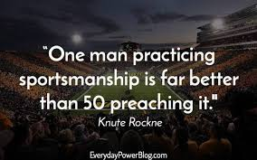
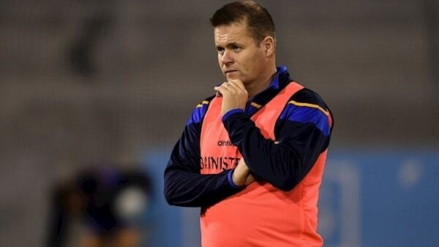
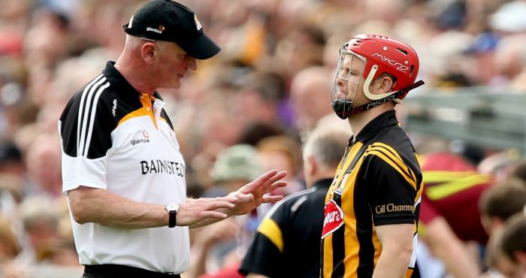
Unit 4: Sports Leadership
Content = Learners study what makes a good leader, the different capacities of this role, and the leadership skills and techniques necessary when leading activities in different roles.

Slide 7
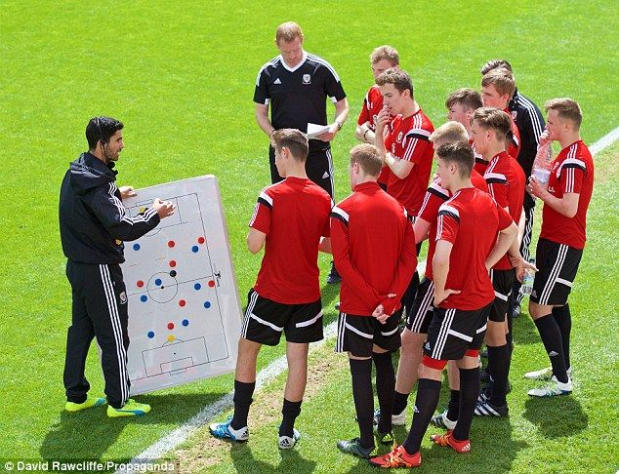
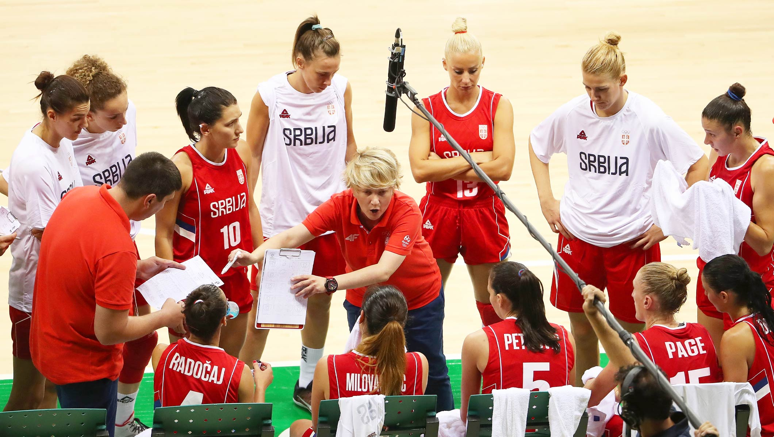
Unit 4 Assessment.
Sample Assessment Task
Explore an effective leadership style when leading a team during sport and exercise activities

Slide 8
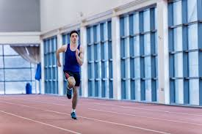
What could this qualification lead to? For learners who wish to study an aspect of sport in higher education, opportunities include:
BA (Hons) in Sport Studies and Business, if taken alongside A Levels in Business and Maths
BSC (Hons) in Sport Psychology, if taken alongside a BTEC National Extended Certificate in Applied Science and A Level in Psychology
BA (Hons) in Sports Education and Special and Inclusive Education, if taken alongside an A Level in English Language and a BTEC National Extended Certificate in Performing Arts
BA (Hons) in Sport and Exercise Science, if taken alongside a BTEC National Diploma in Applied Science. Learners should always check the entry requirements for degree programmes with specific higher

